Slide 1

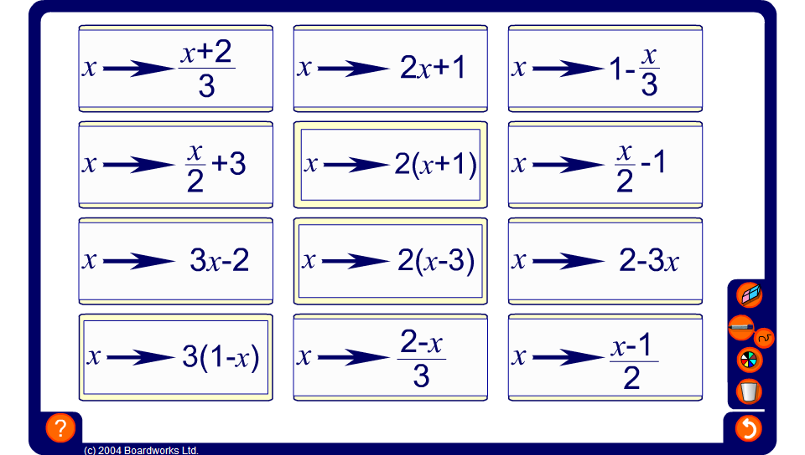


Functions and inverses
Notes:
Use this activity to practise matching functions with their inverses.

